Slide 1

FInding a Better Place in Scarborough, Toronto by using Clustering and Data Location
Capstone Project

Slide 2

AGENDA
Introduction
Data
Methodology
Analysis
Results
Conclusion

Slide 3


Slide 4
Introduction
The purpose of this Capstone Project is to help people in exploring better facilities around their neighborhood. It will help people making smart and efficient decision on selecting great neighborhood out of numbers of other neighborhoods in Scarborough, Toranto.
The aim is to create a report to search the best neighborhood by a comparative analysis between neighborhoods.

Slide 5
Data
Wikipedia: Contain latitude and longitude, zip codes. https://en.wikipedia.org/wiki/List_of_postal_codes_of_Canada:_M
Foursquare API Data:
Contain data about different venues in different neighborhoods.

Slide 6
Data
The data retrieved from Foursquare contained information of venues The information needed per venue are the following:
1. Neighborhood
2. Neighborhood Latitude
3. Neighborhood Longitude
4. Venue
5. Name of the venue e.g. the name of a store or restaurant
6. Venue Latitude
7. Venue Longitude
8. Venue Category

Slide 7

Methodology
To compare the similarities of two cities, we decided to explore neighborhoods, segment them, and group them into clusters to find similar neighborhoods.
It was used Clustering technique to group them per categories.

Slide 8
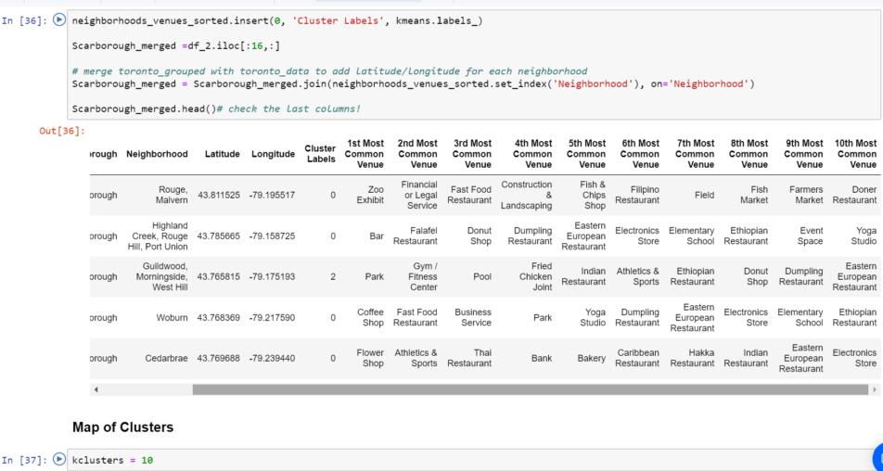
Methodology: Most Common Venue

Slide 9
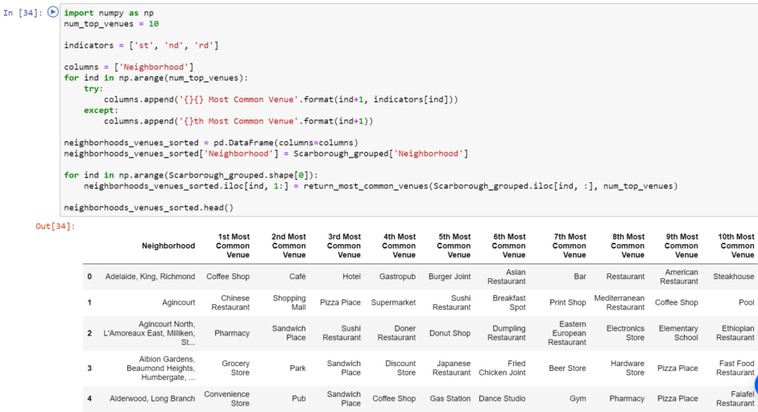
Methodology: Using Clustering

Slide 10
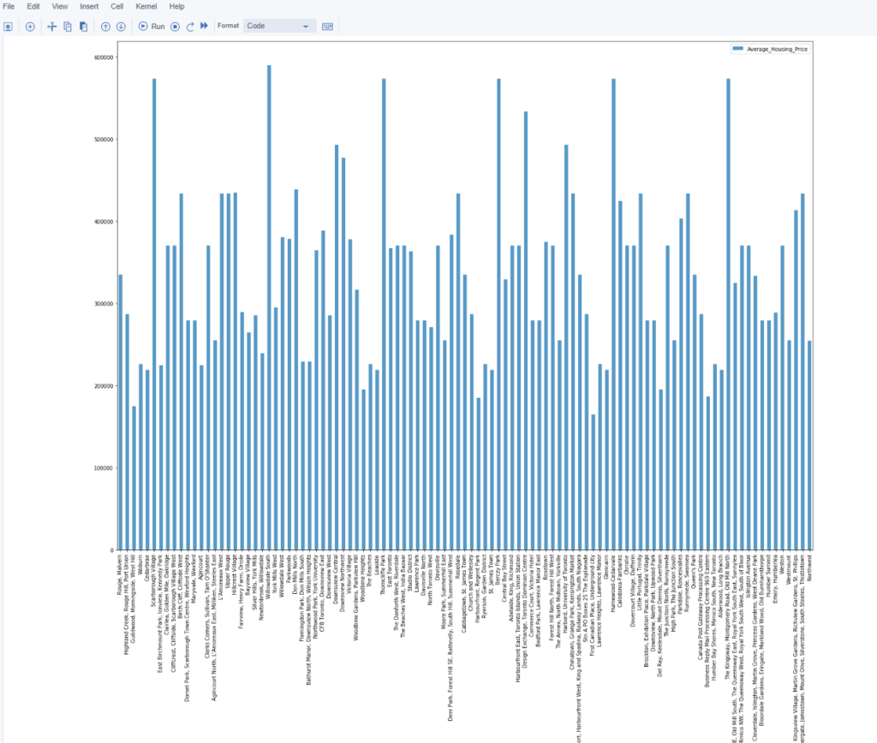
Analysis: Average Housing Price by Clusters in Scarborough

Slide 11
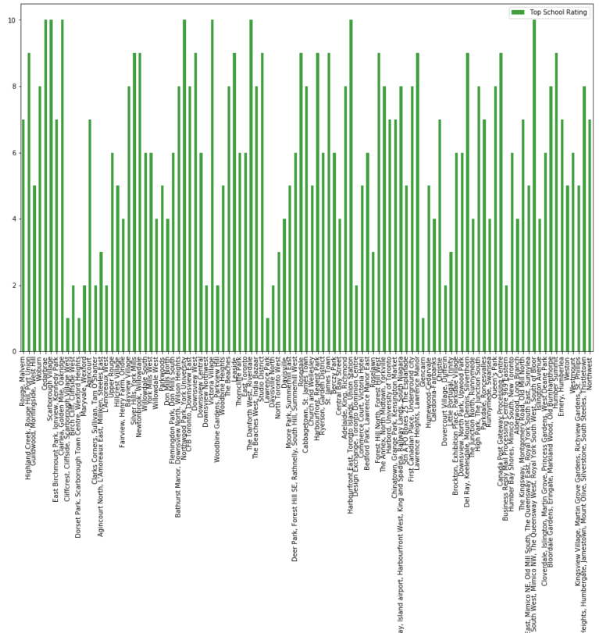
Analysis: Average Housing Price by Clusters in Scarborough

Slide 12

Results: Map of Clusters in Scarborough

Slide 13
Conclusion
Using k-means cluster algorithm to separate the neighborhood into 10 different clusters, which have very-similar neighborhoods around them.
Using the charts above results presented to a particular neighborhood based on average house prices and school rating help people is to choose a better neighborhood in Scarborough.

